Slide 1


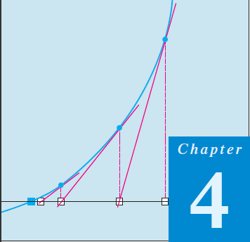
Thomas Calculus 11th
06
Application Of Differentiation
Samuel Lukas

Slide 2
Agenda
Rates Equations
Extreme Values of Functions
Increasing and Decreasing Functions
Concavity and Curve Sketching
Applied Optimization Problems
L’Hopital’s Rules

Slide 3
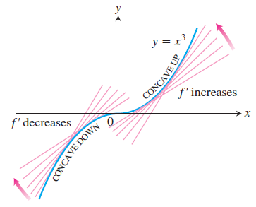


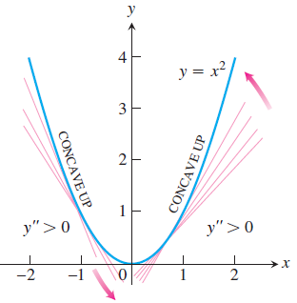



Concavity and Curve Sketching
$$y=3+sin(x)$$
$$y′=cos(x)$$
$$y^{′′}=−sin(x)$$

Slide 4
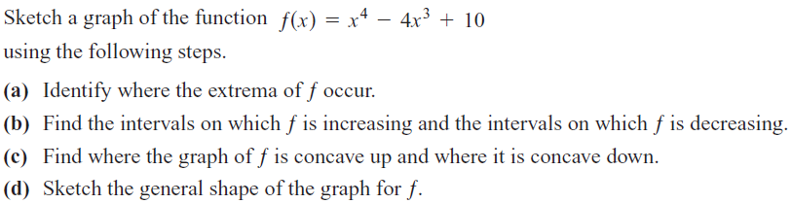

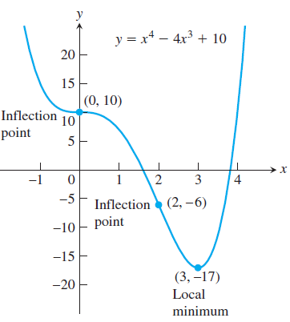

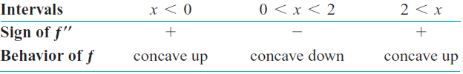

Examples

Slide 5


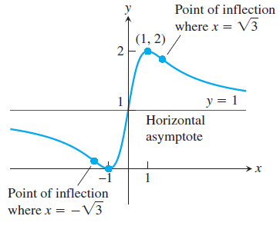
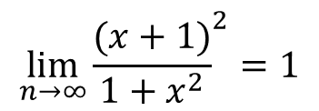



$$x=0→f\left(0\right)=1→(0,1)$$
$$y=0→{(x+1)}^{2}=\left(0\right)→(−1,0)$$
Extreme points
$$f^{′}\left(x\right)=0→{(1−x}^{2})=0→x=±1→\{\left(−1,0\right),(1,2)\}$$
Points of inflections
$$f^{′′}\left(x\right)=0→{(x}^{2}−3)=0→x=±\sqrt{3}$$
$$\lim_{n→∞}{{\frac{(x+1)}{1+x^{2}}}^{2}=1}$$
Horizontal asymptote :

Slide 6









Exercises
Plot the functions in Exercises 1–9. Identify the intervals on which the functions are concave up and concave down.

Slide 7
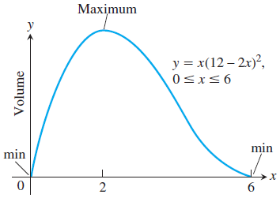
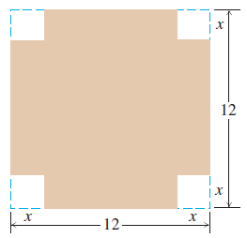
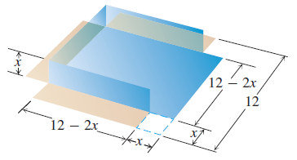

Applied Optimization Problems
To optimize something means to maximize or minimize some aspect of it.
An open-top box is to be made by cutting small congruent squares from the corners of a 12-in.-by-12-in. sheet of tin and bending up the sides. How large should the squares cut from the corners be to make the box hold as much as possible?

Slide 8
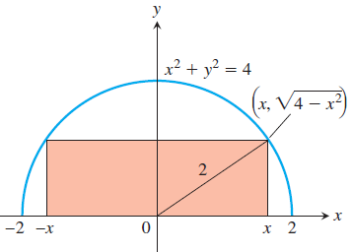




Examples

Slide 9
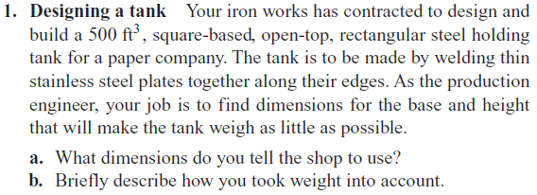

Exercises

Slide 10
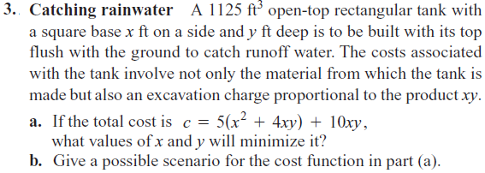
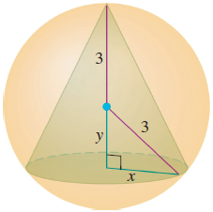

Slide 11

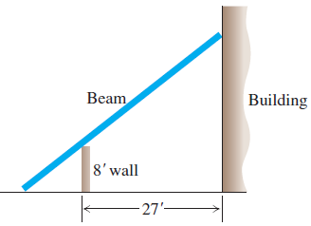
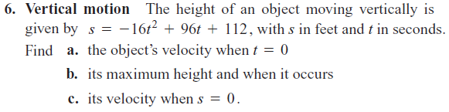

Slide 12
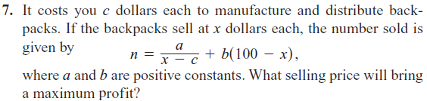
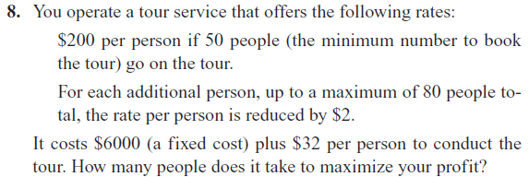

Slide 13
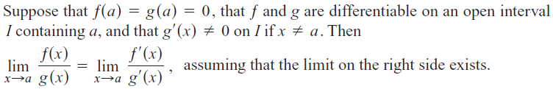












L’Hôpital’s Rule

Slide 14




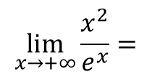
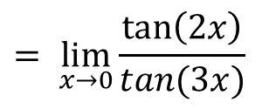

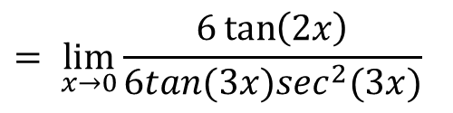
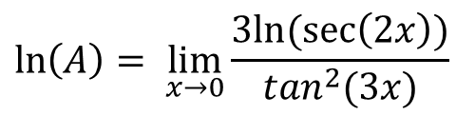
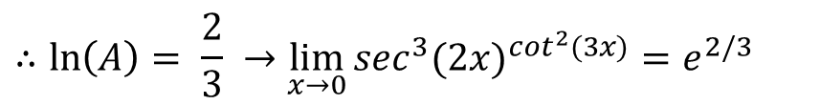

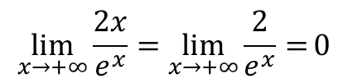

Other Examples
$$\lim_{x→+∞}{\frac{x^{2}}{e^{x}}=}$$
$$\lim_{x→+∞}{\frac{2x}{e^{x}}=\lim_{x→+∞}{\frac{2}{e^{x}}=}0}$$
$$\lim_{x→+∞}{x^{2}e^{−x}=}$$
$$\lim_{x→0}{{\sec^{3}(2x)}^{\cot^{2}(3x)}=A}$$
$$\ln\left(A\right)= \lim_{x→0}{\frac{3ln⁡(\sec\left(2x\right))}{\tan^{2}(3x)}}$$
$$= \lim_{x→0}{\frac{6\tan\left(2x\right)}{6tan(3x)\sec^{2}(3x)}}$$
$$= \lim_{x→0}{\frac{\tan\left(2x\right)}{tan(3x)}}$$
$$\lim_{x→0}{\sec^{2}(3x)=1}$$
$$∴ln\left(A\right)= \frac{2}{3} →\lim_{x→0}{{\sec^{3}(2x)}^{\cot^{2}(3x)}=e^{2/3}}$$

Slide 15







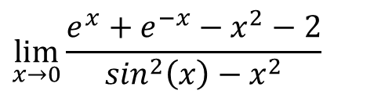
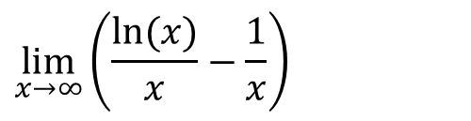



Exercises
01
02
03
04
$$\lim_{x→0}{\frac{e^{x}+e^{−x}−x^{2}−2}{\sin^{2}\left(x\right)−x^{2}}}$$
05
06
07
$\lim_{x→π/4}{(1−\tan\left(x\right))sec⁡(2x}$)
08
$$\lim_{x→0^{+}}{x^{sin⁡(x)}}$$
09
$$\lim_{x→π/2}{{(sin⁡(x)−\cos\left(x\right))}^{tan⁡(x)}}$$
10
$$\lim_{x→∞}{{(1−e^{−x})}^{e^{x}}}$$
11
$$\lim_{x→∞}\left(\frac{ln⁡(x)}{x}−\frac{1}{x}\right)$$
12
$$\lim_{x→0}{(cos⁡({x))}^{1/x}}$$

